Slide 1




SUPPORTING, MOBILIZING & EMPOWERING
CREATIVE AND CULTURAL INDUSTRY
ENTREPRENEURS AND EDUCATORS
TOWARDS SOCIAL CHANGE
Guide
“How to use the CENTAUR e-platform”
The European Commission support for the production of this publication does not constitute an endorsement of the contents which reflects the views only of the authors, and the Commission cannot be held responsible for any use which may be made of the information contained therein.

Slide 2





Partners

Slide 3

Objectives
Guide: How to use the CENTAUR e-platform
After reading this Guide you will:
get familiarized with the CENTAUR platform
be able to browse and view the available online material
understand as a trainer/training organization what the material is about and how you can use it

Slide 4
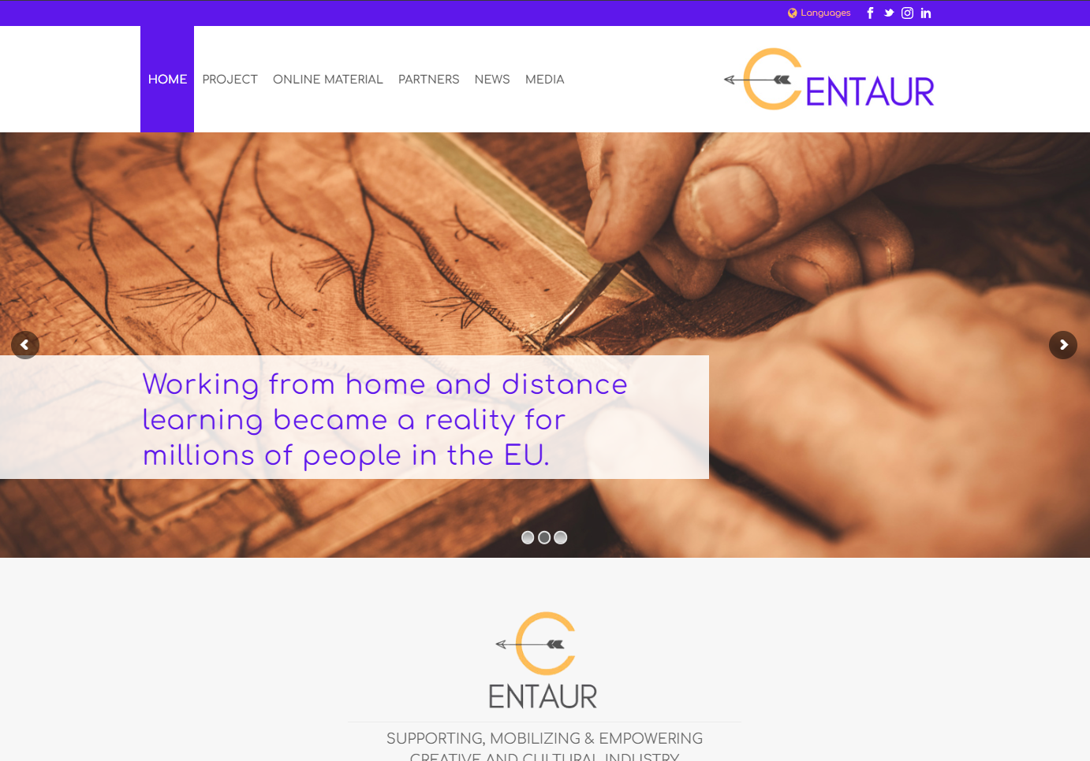
What is the CENTAUR e-platform?
Introduction
The CENTAUR platform is an online platform that hosts all the material developed in the context of the Erasmus+ Project CENTAUR (www.centaur-project.eu).
The platform is addressed to
Professionals in the Creative Art Sector (CAS), i.e. artists in the performing and visual arts, who may be unemployed and cannot use their potential.
People working with adults on a regular basis (teachers, social workers, employees of NGOs, etc.), who have so far not made efficient use of online activities in the creative fields.
Every-day people, who wish to enhance their life skills by developing creativity.
www.centaur-project.eu

Slide 5
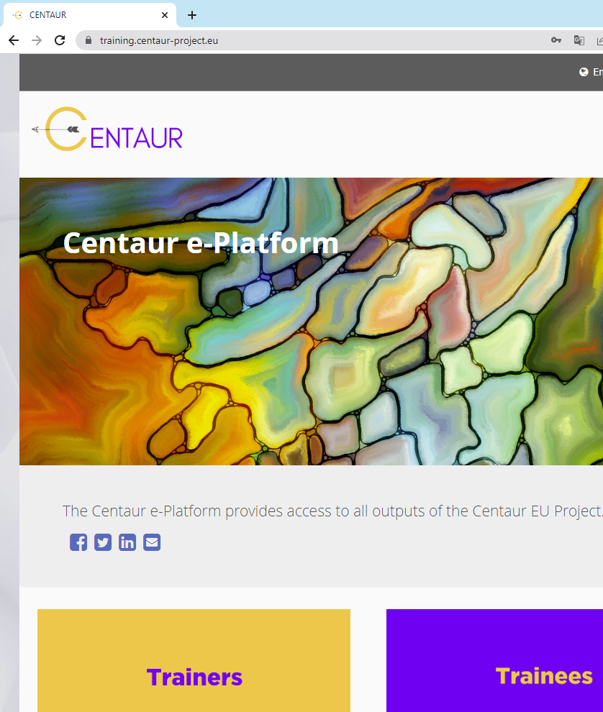
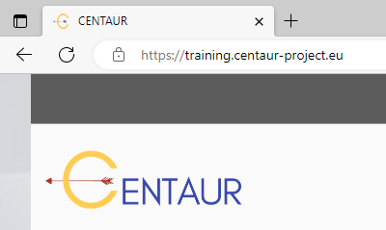
The link
Introduction
The CENTAUR e-platform is available online and has a separate link for direct access.
Follow the link:
training.centaur-project.eu
It is safe to visit this site. See the “https” and the locker icon!

Slide 6
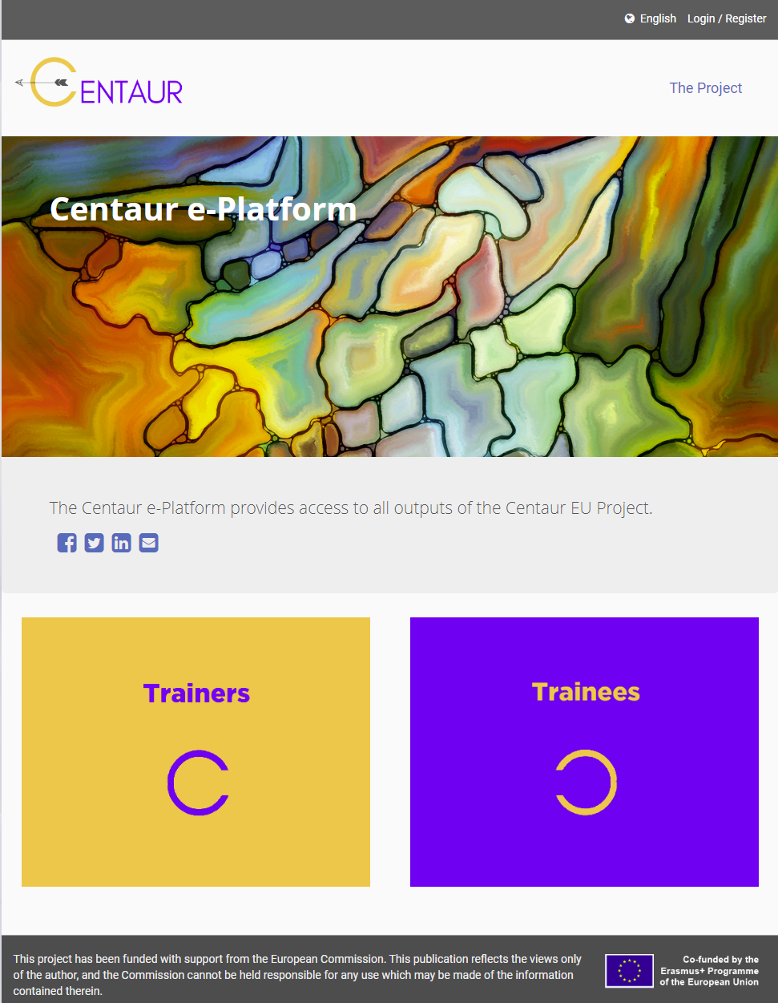
The structure of the Platform
Introduction
The platform includes the following sections:
The “Language and Login/Register” section
The “Links” section
The “Sharing to Social Networks” section
The “online Material” section
The “Disclaimer and Terms of Use” section

Slide 7
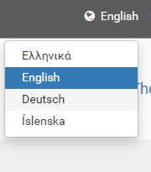
Choose your language
Introduction
Choose one of the available languages by clicking on the “Earth’s icon or the Language name”
Four (4) different languages are supported.
All training content is available on these languages.
  English
  Deutsch
  Greek
  Icelandic

Slide 8

No need for Registration or Login
Introduction
There is no need for Registration or Login to the platform, unless you are a Trainer, who:
  attends the online Training Trainer Course and wishes to view the progress bar or receive badges upon the completion of each unit,
  participates to the Hub for communication with other trainers and networking.
All the content is open, free of cost and available under the open licenses of Creative Commons (BY-NC-SA)!

Slide 9

Sharing the link via Social Media Networks
Introduction
You may share the link of the platform via popular Social Media Networks or send it by e-mail.
Just, click on the icon of your favorite app
of sharing information.

Slide 10
The typical usage scenarios
The main roles of Trainer and Trainee are explained as well as the typical usage scenarios of the CENTAUR platform for these two roles.

Slide 11
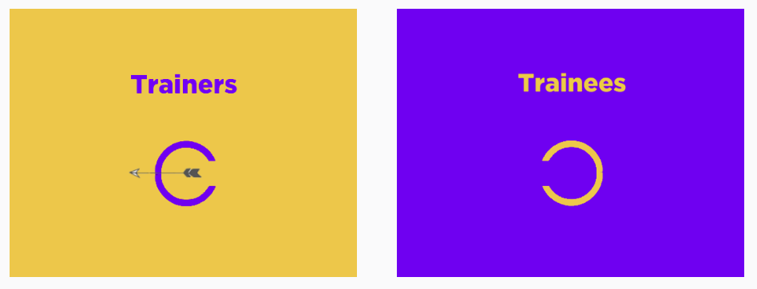
Main roles: Trainer and Trainee
Typical Usage Scenarios
The CENTAUR platform
  provides rich functionality and
  is addressed to Trainers and Trainees.
Before elaborating on the usage scenario, let’s examine the terms Trainers and Trainees.
Trainers: People like, artists, culture experts, people working on adult education, who carry out training activities and wish to use the CENTAUR material (exercises) and platform into their training sessions (CENTAUR based training sessions).
Trainees: Every-day people that may
  attend specific CENTAUR based training sessions with trainer’s guidance, or
  access online the CENTAUR exercises suitable for self-study (without any trainer’s guidance)

Slide 12

What CENTAUR offers to a trainer
Typical Usage Scenarios
The CENTAUR platform offers the following to a trainer:
The CENTAUR set of exercises that may be used by a trainer in a face-to-face training setting. The platform provides searching functionality.
The CENTAUR Self Assessment Tool (SAT), mainly addressed to the trainees, which produces a report on the most relevant exercises. These reports help the trainer to select the most suitable exercises for a specific group of trainees.
The CENTAUR Guidelines and online Training Course on how to use the CENTAUR platform.
The CENTAUR Hub for networking and communication with other Trainers for sharing experiences on how to apply the CENTAUR exercises.
An Artists/Trainers Database in which an Artist/Trainer may add his/her contact details and CV.
The CENTAUR Adults Learners Space which can be requested by a Trainer for administrating the communication with the trainee group.
The CENTAUR Mobile App, for proposing to a specific trainee online self-study exercises.

Slide 13
What CENTAUR offers to a trainee
Typical Usage Scenarios
The CENTAUR platform offers to a trainee:
An Artists/Trainers Database for searching a trainer.
The CENTAUR Self Assessment Tool (SAT) for identifying the most interested exercises for the trainee.
In case of online user, the CENTAUR set of self-study exercises.
The CENTAUR Mobile App which provides the self-study exercises in a flexible and engage manner making use of Avatar and gamification elements.
An Adults Learners Space for communicating with the Trainer and the other Trainees.

Slide 14
Typical usage scenarios of the CENTAUR platform
Typical Usage Scenarios
A. Trainer’s scenario
Preparation process for a Trainer
The Trainer organizes f2f training sessions
B. Trainee’s scenarios
Trainee’s preparation for participating in a f2f training session
A Trainee participates in a f2f training session
Any online Trainee uses self-study, without guidance, exercises

Slide 15
Usage scenario 1 - Preparation process for a Trainer
Typical Usage Scenarios
The Trainer
1. Reads the Guidelines
2. Completes the Trainer Training Course
3. Uses the HUB for networking and communication*
4. Adds contact details and CV to the Artists /Trainers Data base *
5. Studies the available exercises
* The Trainer may skip this steps.
The Trainer is ready now to
use the CENTAUR platform and tools
organize CENTAUR based f2f training sessions
find trainees for the f2f training sessions

Slide 16
Usage scenario 2 - The Trainer organizes f2f training sessions
Typical Usage Scenarios
The Trainer has formed the group of trainees.
1. Communicates and forms the group of trainees
3. Selects, based on SAT result reports, the common suitable exercises for the specific group of trainees for the f2f training session
2. Invites trainees to complete the SAT and receives from the trainees the results reports
The Trainer is ready now to
carry out the f2f training session

Slide 17
Usage scenario 3 - The Trainer makes use of the Adult Learners Space during a f2f training session
Typical Usage Scenarios
The Trainer has formed the group of trainees.
The Trainer needs a space only if the f2f training period is extended !
1. The trainer sends an email to CENTAUR partners* and applies for an AL Space
3. The trainer uses the specific AL Space during the extended f2f training period
2. Upon receiving details for the AL Space, the trainer communicates the credentials to the trainees group
*Read last slide

Slide 18
Usage scenario 4 – Trainee’s preparation for participating in a f2f training session
Typical Usage Scenarios
The Trainee
1. Searches the CENTAUR Artists/Trainer Data Base to find a Trainer
2. Communicates with the Trainer about the availability of the next f2f training session
3. Expects invitation from the Trainer for the next f2f training session

Slide 19
Usage scenario 5 – A Trainee participates in a f2f training sessions
Typical Usage Scenarios
The Trainee
1.Receives invitation, completes the CENTAUR SAT and sends the report to the Trainer
2. Attends the f2f training session

Slide 20
Usage scenario 6 – Any online Trainee uses self-study without guidance exercises
Typical Usage Scenarios
The Trainee
1.Completes the SAT tool for identifying the most interesting CENTAUR exercises*
2. Downloads the CENTAUR Mobile App for accessing the CENTAUR self-study exercises
* The Trainee may skip this steps.

Slide 21

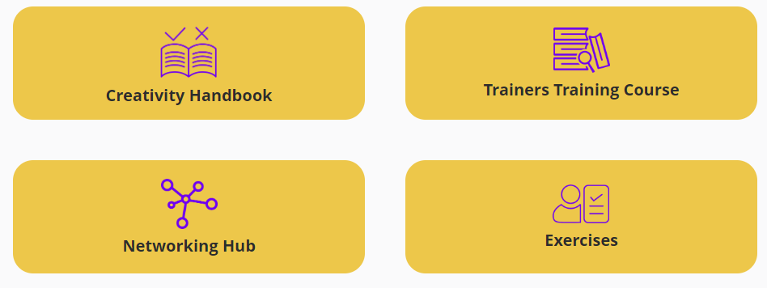
Functionality for a Trainer

Slide 22

Creativity Handbook
Functionality for a Trainer
By clicking on the box “Creativity Handbook” you may download the handbook (IO Guidelines) in a pdf format.

Slide 23

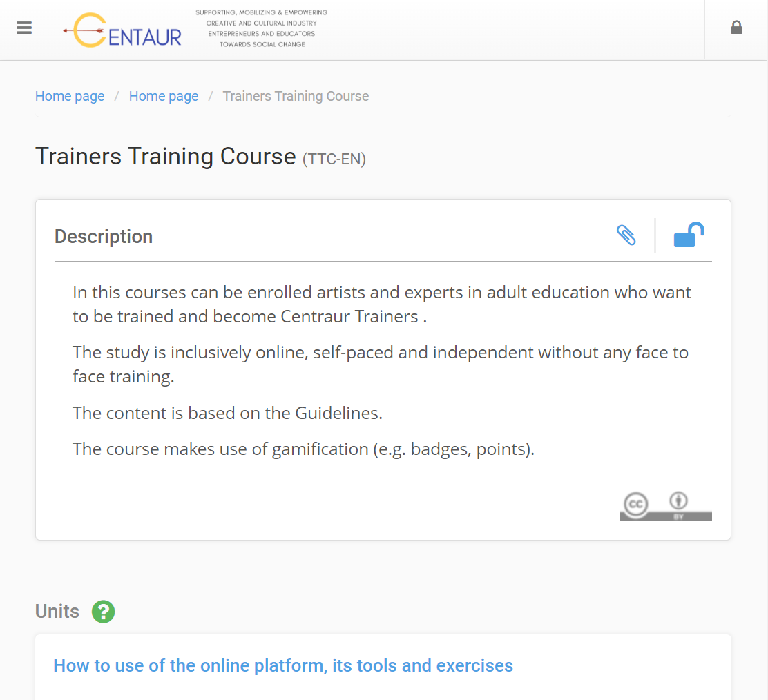
Trainers Training Course
Functionality for a Trainer
By clicking on the blue box “Trainers Training Course” a user access an online course which is addressed to Trainers.
They can learn how to use the CENTAUR Platform.
The study is online, self-paced and independent, without any face-to-face training.
The content is based on the Guidelines.
The course makes use of gamification (e.g., badges, progress), if the Trainer is registered.

Slide 24

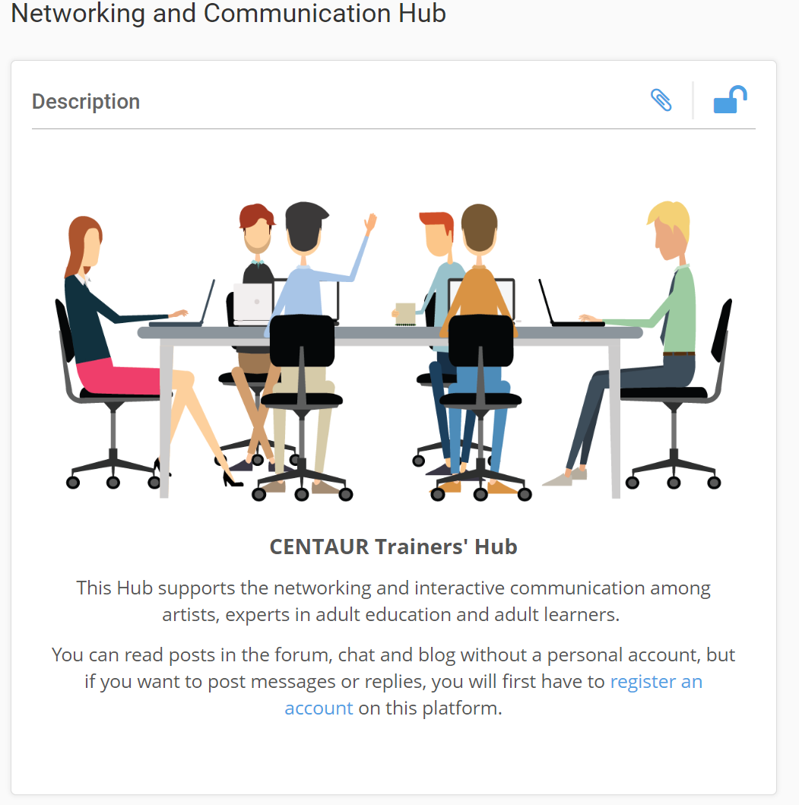
Networking Hub
Functionality for a Trainer
By clicking on the blue box “Networking Hub” the user accesses the CENTAUR Hub for Networking and Communication with other Artists and Trainers for exchanging ideas and experiences.
So, this Hub supports the networking and interactive communication among artists, experts in adult education and adult learners.
A Trainer first has to register/create an account on this platform, and then log in. Anyone may get registered since open registration is supported. Then, she/he may read posts in the forum, chat and blog.

Slide 25

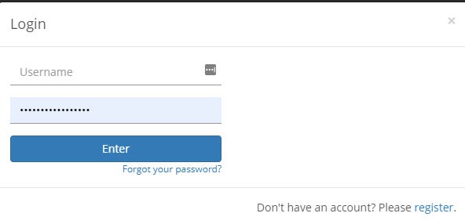
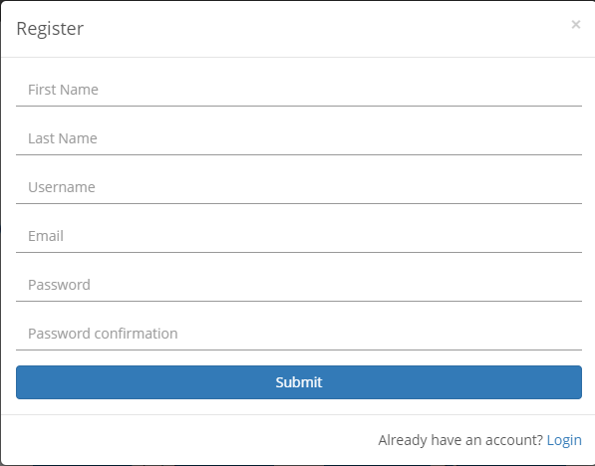
How to register
(1)
Follow these steps for registration
(2)
(3)

Slide 26
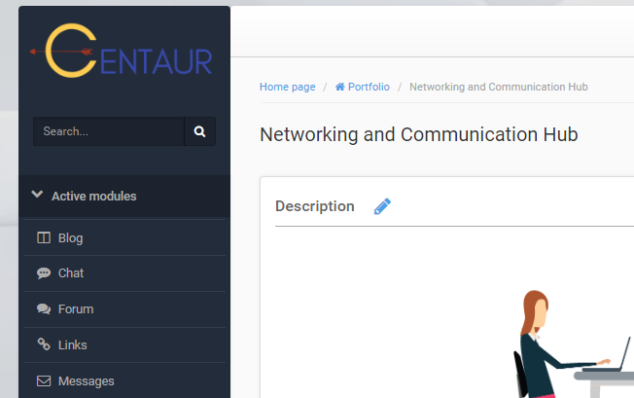
How to use the HUB
You, as a registered/logged in Trainer, may use the following functionality:
Messages: Exchange messages among the participants, that is other Artists and Trainers.
Chat: The participants may send chat texts to each other.
Forum: You may create one or more forum topics and ask trainees to participate on these.
Blogs: Read and posts blogs on specific thematic.

Slide 27
Be added, as a Trainer, to the CENTAUR Data Base
Registered Trainer may use the specific form for inserting their information into the CENTAUR Artists/Adult Training Data Base.
This form is available in the CENTAUR Hub.

Slide 28

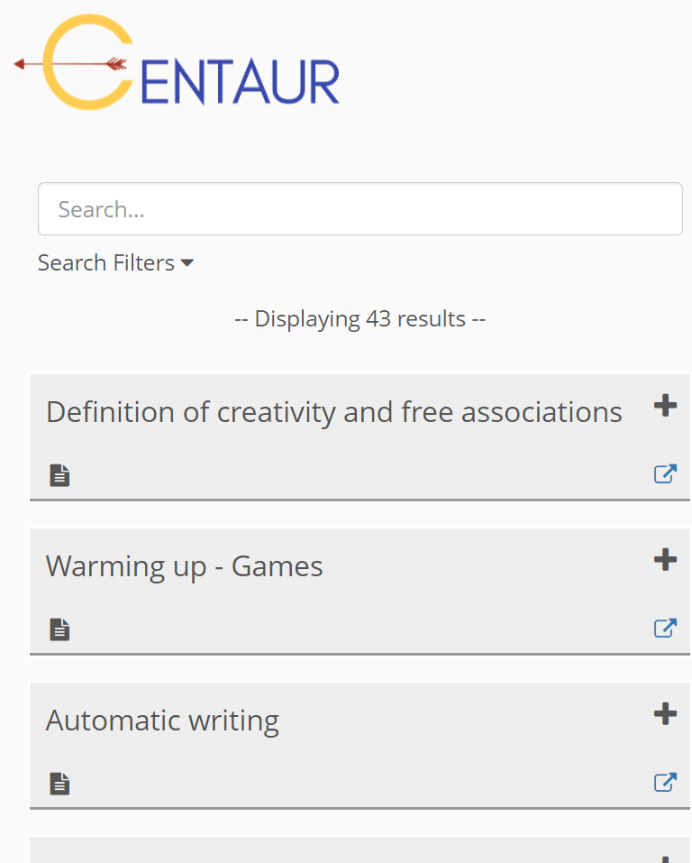
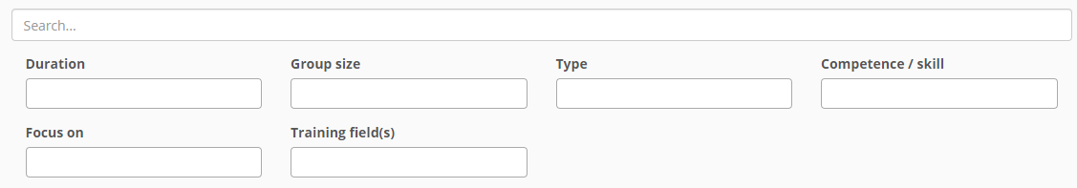
Exercises
Functionality for a Trainer
By clicking on the blue box “Exercises” a user may access the available set of the exercises, which appears as a list.
Then, the user may filter the exercises by applying the key-word based search or use the available Search Filters.

Slide 29
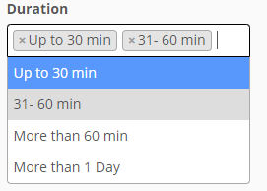
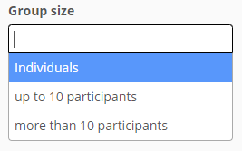
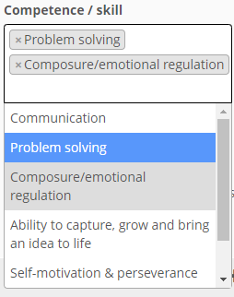
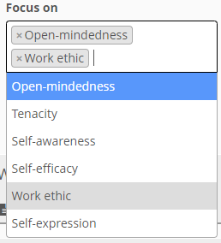
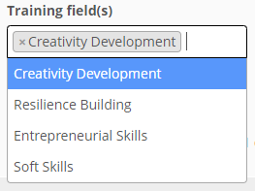
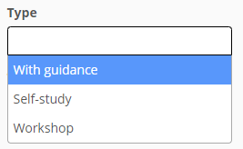
Search Filters for the Exercises
Functionality for a Trainer
The exercises may be filtered by selecting one or more values in the various search fields, and of course combine more than one search field.

Slide 30
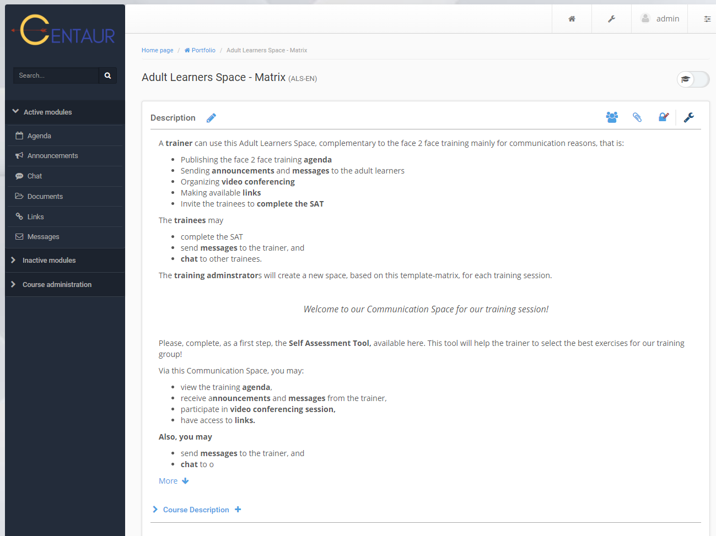
How to use the dedicated Adult Learners Space
A trainer can use this Adult Learners Space, complementary to the face 2 face training, mainly for communication reasons, that is:
Publishing the face 2 face training agenda
Sending announcements and messages to the adult learners
Organizing video conferencing
Making available links
Invite the trainees to complete the SAT, if not done yet

Slide 31

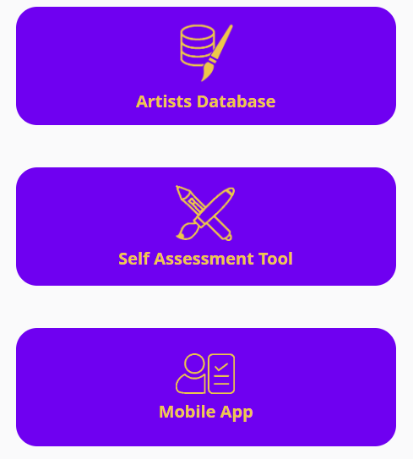
Functionality for a Trainee

Slide 32

Artists/Trainer Data Base
Functionality for a Trainee
The Trainee, by following the green box “Artist Data Base”, may search the data base for trainers that are carrying out CENTAUR based or similar training sessions and ask about the schedule of the training sessions and trainer’s availability.
Information about the Trainers appear, such as CV, short description, contact details, photo.

Slide 33

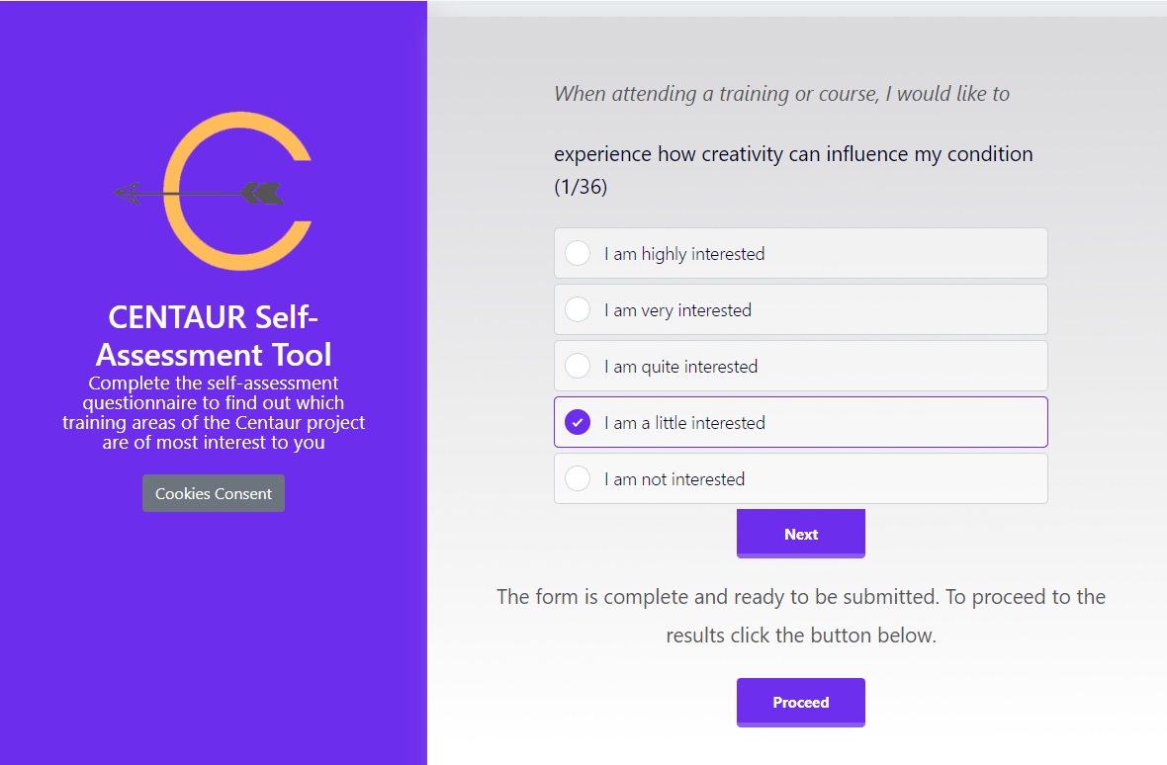
Self Assessment Tool (SAT)
Functionality for a Trainee
The Trainee, by following the green box “Self Assessment Tool”, may find in which of the available exercises she/he is most interested.
It works like this:
The trainee answers 36 statements according to her/his interests:
She/he clicks the most appropriate of the five answer-options.
Then, s/he clicks on the button to go to the next question.
At the end of the questionnaire, she/he clicks on the Submit button.

Slide 34
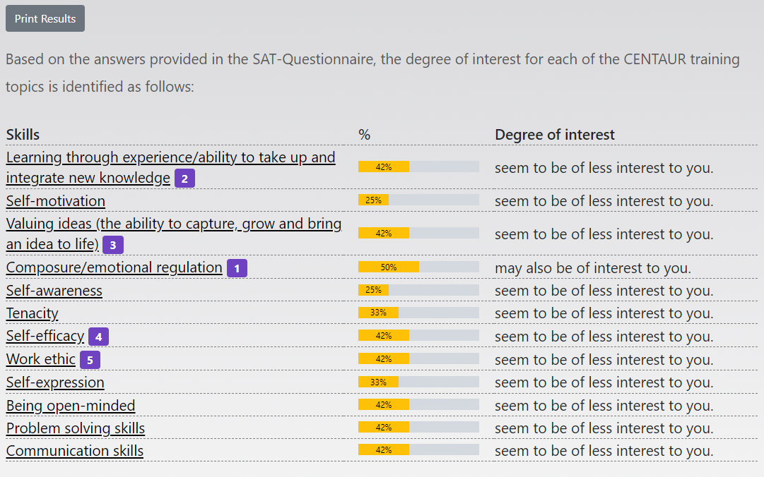
Evaluation results
Functionality for a Trainee
Immediately afterwards the Trainee will receive his/her evaluation.
According to the answers she/he has given, she/he will find out his/her degree of interest in percentages.
The skills and training areas with a score between 75% and 100% comprise the recommendation: are most interesting to you.
Skills and training areas with a score between 50% und 74% comprise the comment: may also be of interest for you.
Between the skill and the degree of interest the Trainee will find a yellow bar, showing the percentage of his/her result.
To facilitate the overview, the trainee will also find the rank of his/her interest directly next to the corresponding skill in the first column as a number (e.g., .3.).

Slide 35
Evaluation results
Functionality for a Trainee
The options to continue depend on whether the trainee plan to attend a seminar or whether she/he is a self-learner.
If she/he plans to attend a seminar, he then downloads or prints the results sheet in pdf and sends it to the Trainer.
If she/he is a self-learner, she/he clicks on the recommended skill. She/he will be redirected to the corresponding exercises on the exercise-database.
If she/he is a self–learner, the Trainee may select from the exercises she/he is interested, those addressed to the self-learners by visiting the link: https://training.centaur-project.eu/virtual-exercises or downloading the CENTAUR Mobile App.

Slide 36


Self-study exercises
Functionality for a Trainee
The Trainee by following the green box “Self-study exercises” may download the CENTAUR Mobile App.
The CENTAUR Mobile App provides only the self-study exercises in an engaging and playful way by proving Avatar(s) as presenter(s) following a gamification approach.
A support trainer may also use this App for choosing a fitting self-study for a specific trainee in contact and under his/her supervision.

Slide 37
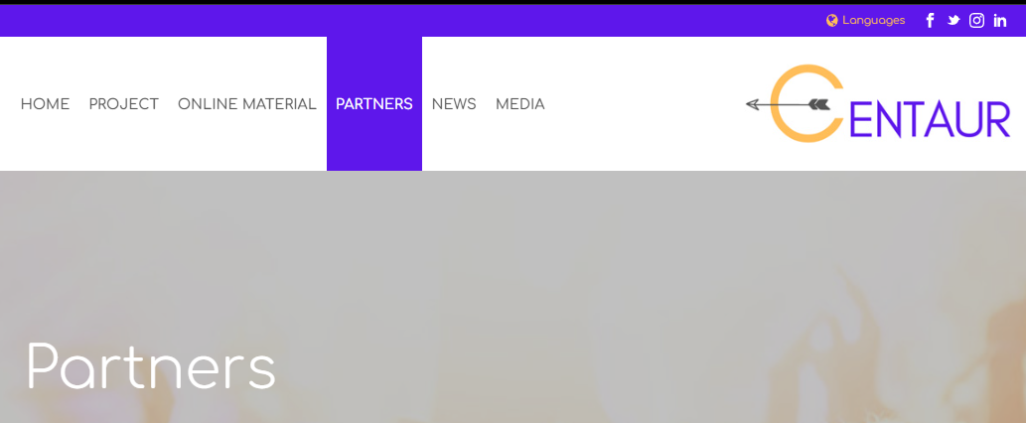
How to contact the CENTAUR partners ?
Visit the project’s website:
https://centaur-project.eu
Go to the partners sections
or click here
3. Find the partner(s) located in your country and
send them email.
4. For other country, contact the coordinator.
CENTAUR Partners

Slide 38
Congratulations!
You have completed this Guide!
The European Commission support for the production of this publication does not constitute an endorsement of the contents which reflects the views only of the authors, and the Commission cannot be held responsible for any use which may be made of the information contained therein.

